Slide 1
ASIL(Vehicle Safety) “AUTOMOTIVE SAFETY INTEGRITY LEVEL”
PREPARED BY:SHUBHAM SUPEKAR

Slide 2
introduction
Automotive Safety Integrity Level is of classifying hazards, risk, quality or reliability scheme defined by the ISO 26262-Functional Safety for Road Vehicle Standard.
There are four ASILs identified by ISO 26262―A, B, C, and D. ASIL A represents the lowest degree and ASIL D represents the highest degree of automotive hazard.
How do ASILs work?
ASILs are established by performing hazard analysis and risk assessment. For each electronic component in a vehicle, engineers measure three specific variables:
Severity (the type of injuries to the driver and passengers)
Exposure (how often the vehicle is exposed to the hazard)
Controllability (how much the driver can do to prevent the injury)
ASIL refers both to risk and risk dependent requirements whereas risk may be expressed as:
Risk=(Expected loss in case of the accident)*(Probability of Accident occurring)
And ASIL may be expressed as:
ASIL=(Severity)*(Exposure)*(Controllability)

Slide 3
The Severity (S) injuries can be classified as:
S0 No injuries
S1 Light to moderate injuries
S2 Severe to life threatening injuries
S3 Life threatening injuries to fatal injuries
The Exposure (E) injuries can be classified as :
E0 Incredibly unlikely
E1 Very low probability
E2 Low probability
E3 Medium probability
E4 High probability

Slide 4
Controllability classification (C):
C0 Controllable in general
C1 Simply Controllable
C2 Normally controllable
C3 Difficult to control
So ASIL D is the highest level of hazard and can be computed as:
ASIL D=S3*E4*C3

Slide 5
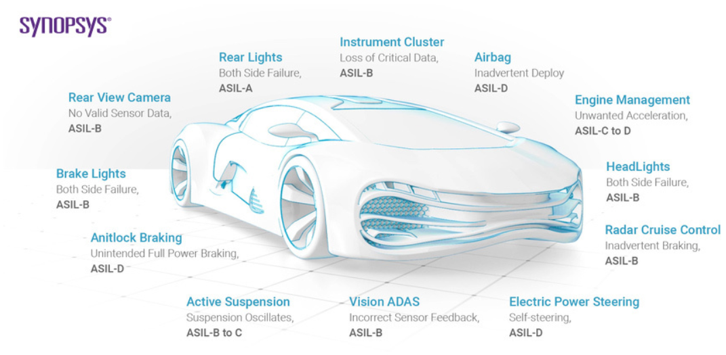
SYNOPSIS OF ASIL

Slide 6
THANK YOU !!!

